Slide 1
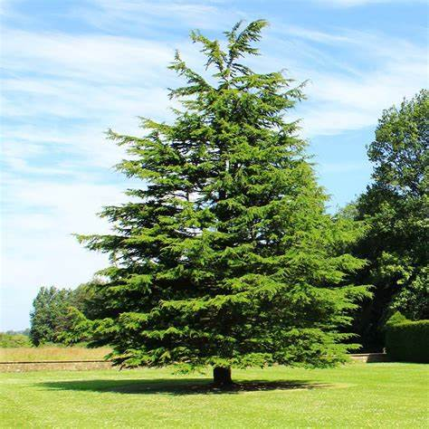
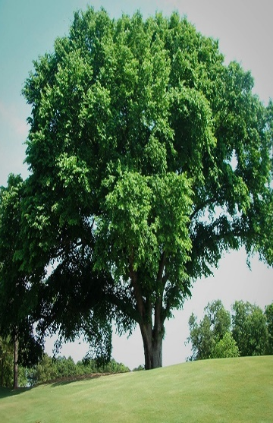
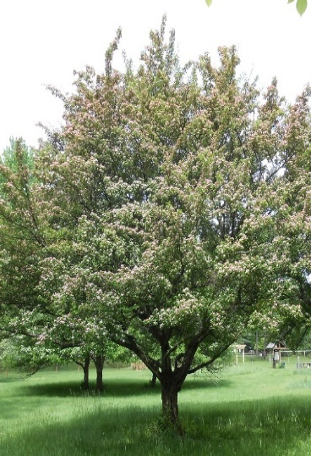
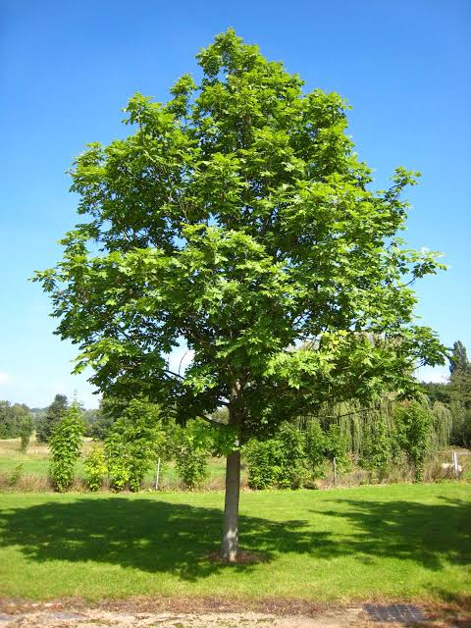
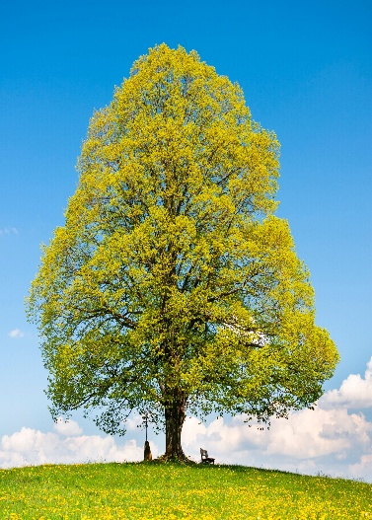
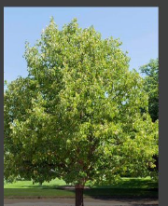
Welcome to Key Stage 2
Cedar Class
Elm Class
Hawthorn Class
Ash Class
Beech Class
Hazel Class

Slide 2
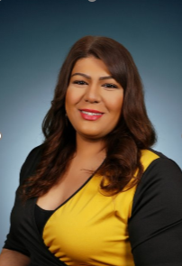
Year 4 - Ash Class
Miss Sharma
P.E. Days – Monday and Thursday
Forest School – Thursday
Library - Friday

Slide 3
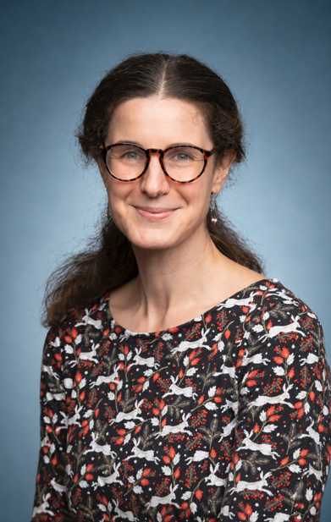
Year 4 -Beech Class
Miss Raw
P.E. Days – Monday and Thursday
Forest School – Tuesday
Library - Friday

Slide 4
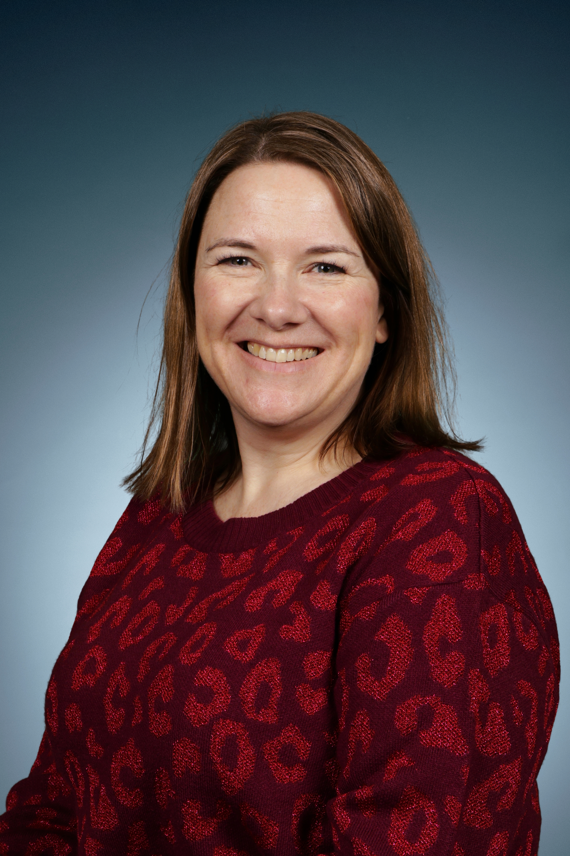

Year 4 - Hazel Class
Mrs Hall and Rosco
P.E. Days – Monday and Thursday
Forest School – Friday
Library – Friday

Slide 5
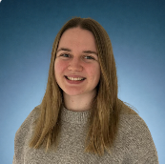
Year 3 - Elm Class
Miss Rickels
PE days – Tuesday and Friday
Forest School – Friday
Library - Thursday

Slide 6

Year 3 – Cedar Class
Mrs Brooker
PE days – Tuesday and Friday
Forest School – Monday
Library - Thursday

Slide 7
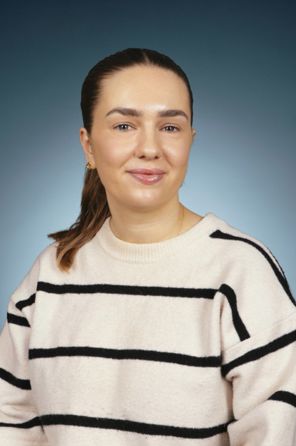
Year 3 - Hawthorn Class
Miss Mansell
PE days –Tuesday and Friday
Forest School – Thursday
Library - Thursday

Slide 8
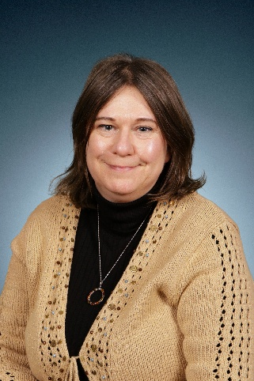
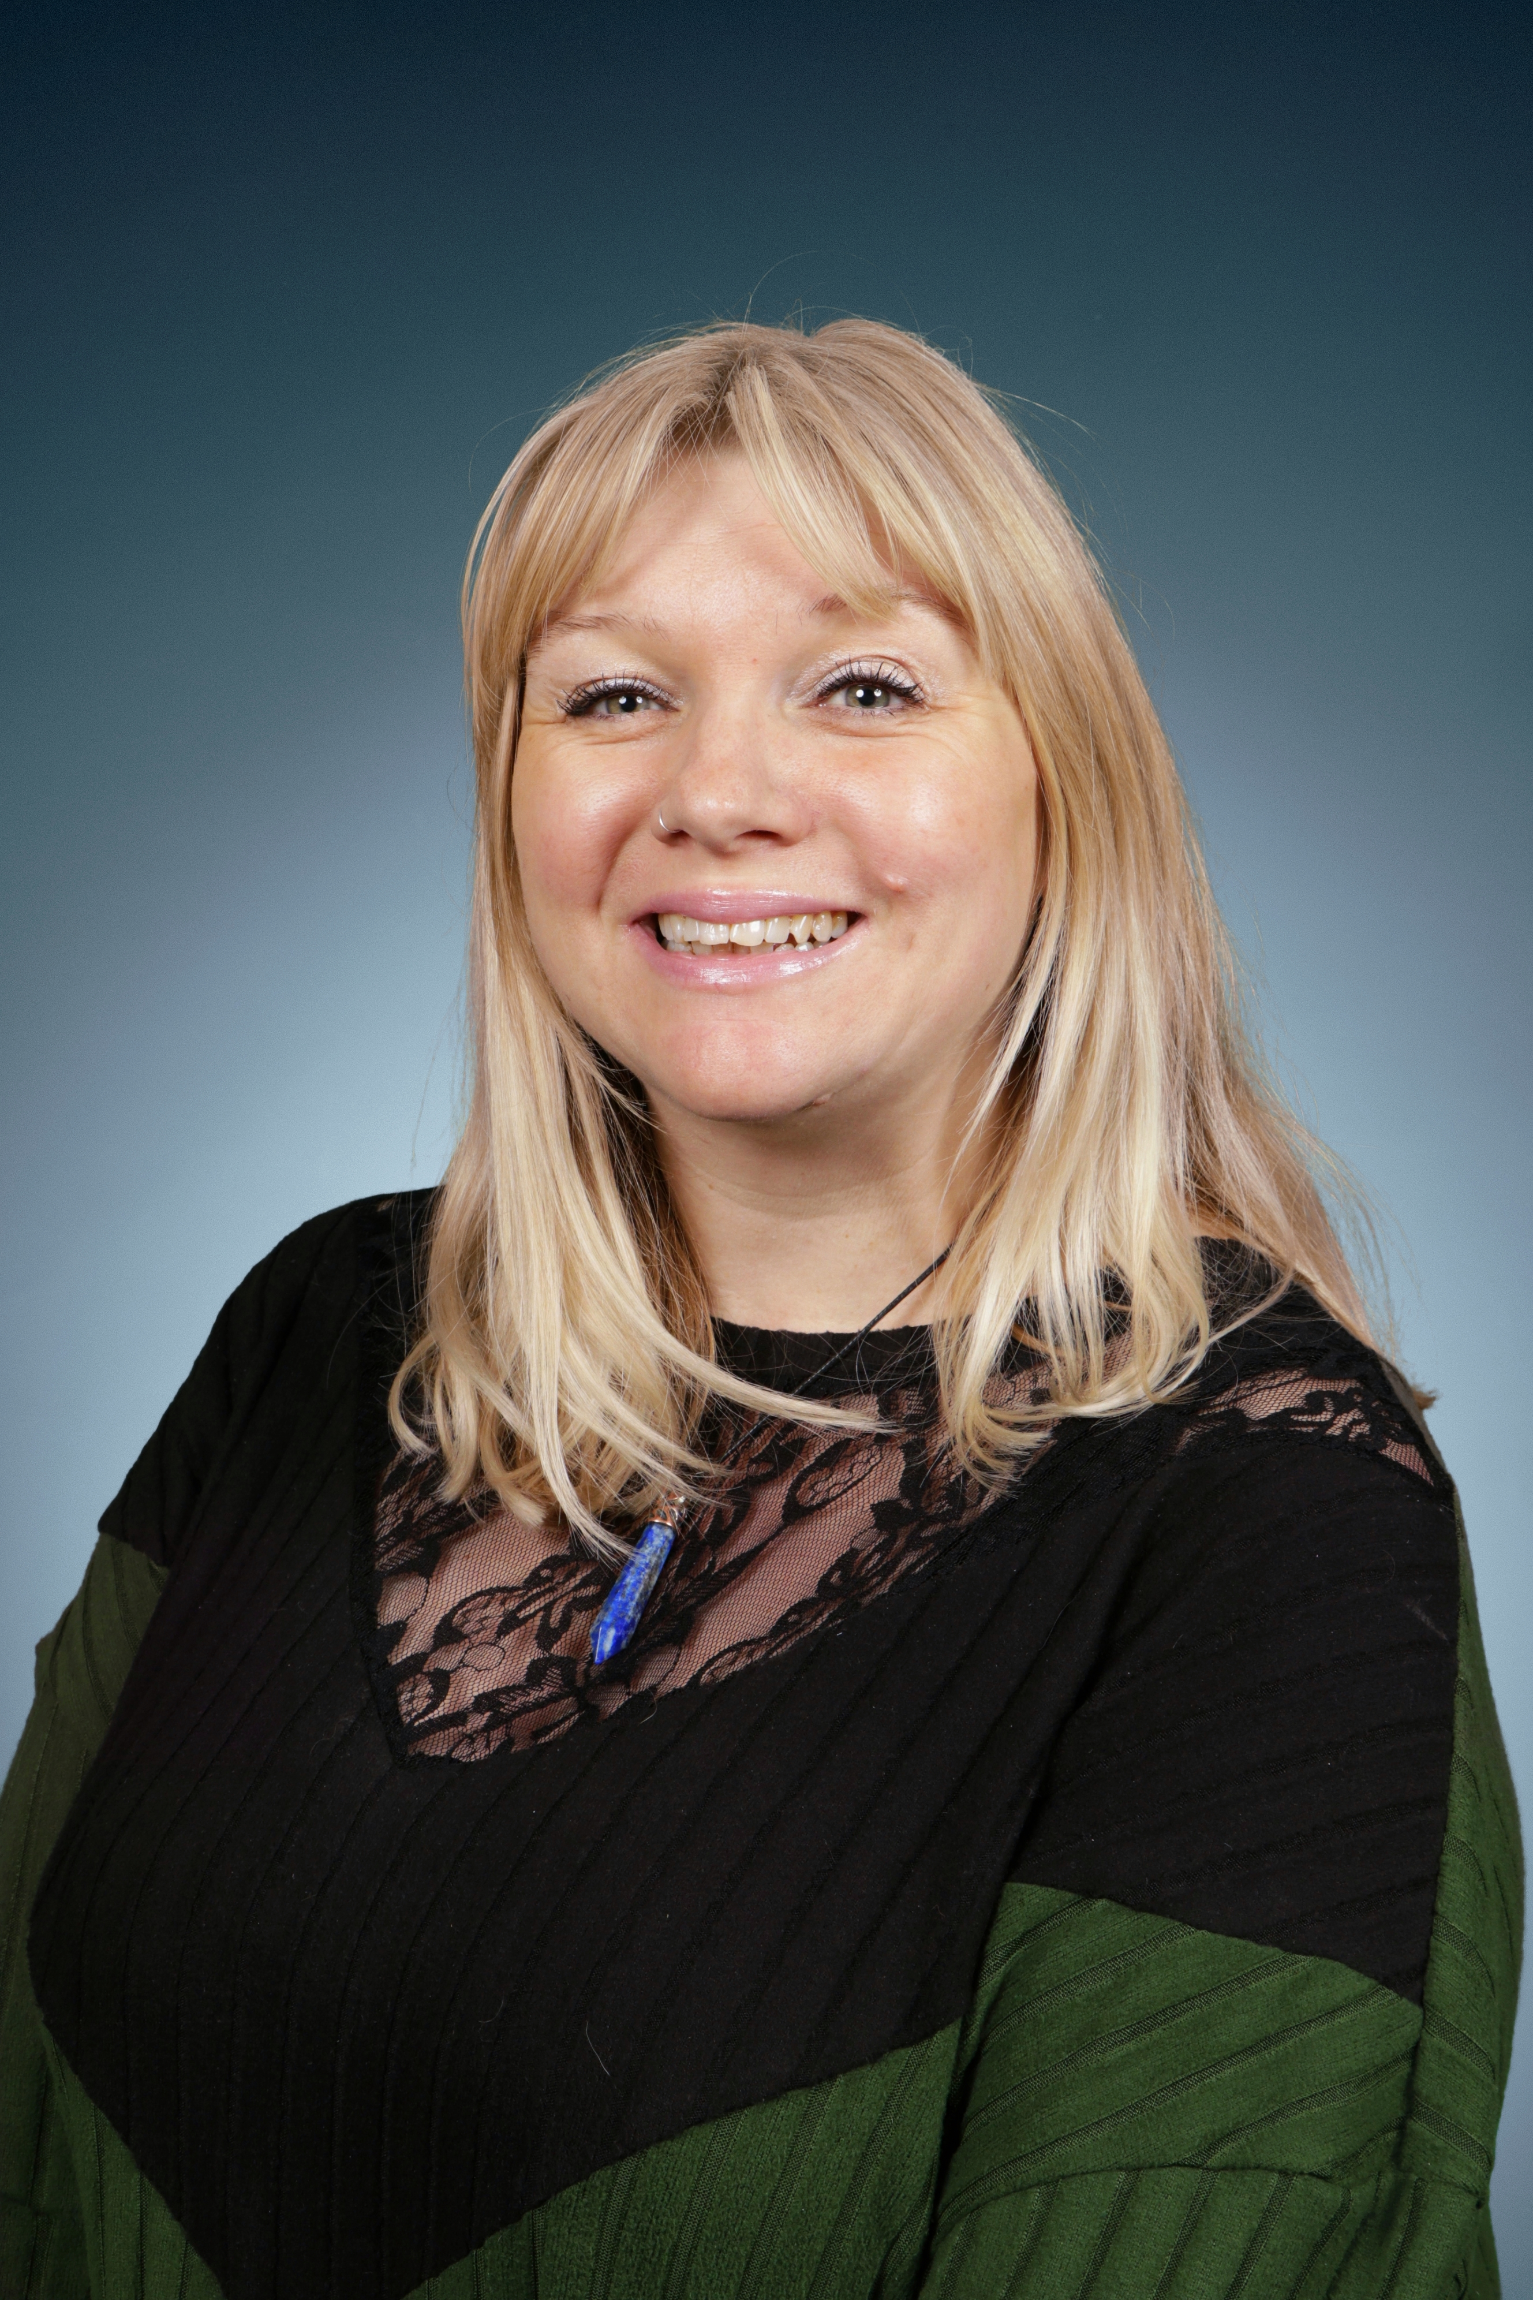
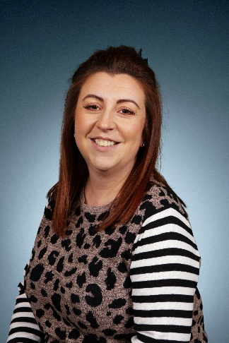
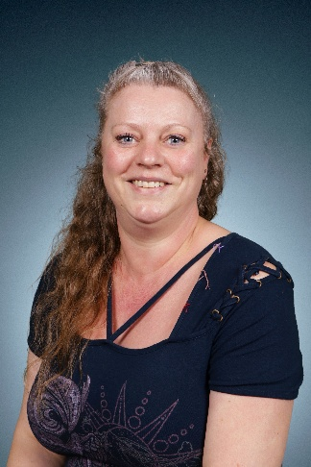
Key Stage 2 TA Team
Mrs Roper
Miss Mathieson
Mrs Herbert
Miss Moore

Slide 9
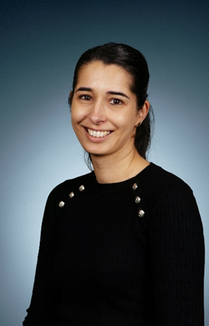
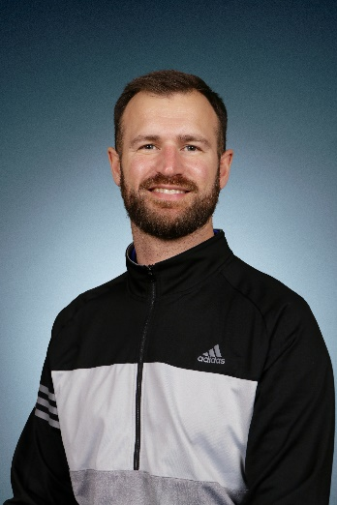
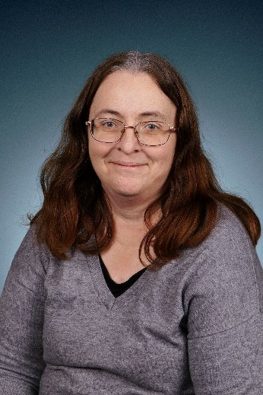
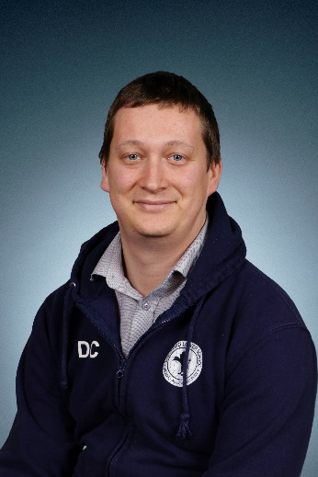
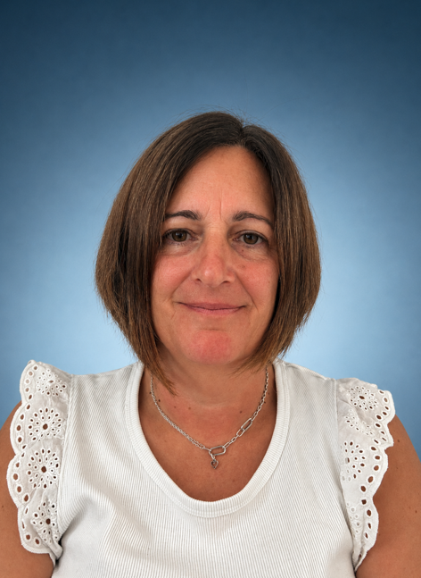
Our Cover Supervisors
Mrs Reynolds
Mr Tilbury
Mrs Barnes
Mr Carter
Mrs Haydon

Slide 10
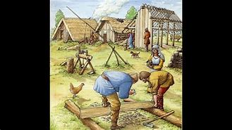


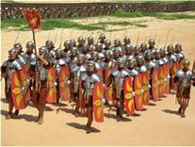
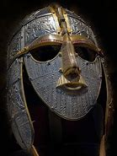
Welcome to Year 4
Autumn: Our Geography and History focus will be Invaders
In Science we will be focusing on Habitats and States of Matter
Invaders Day

Slide 11
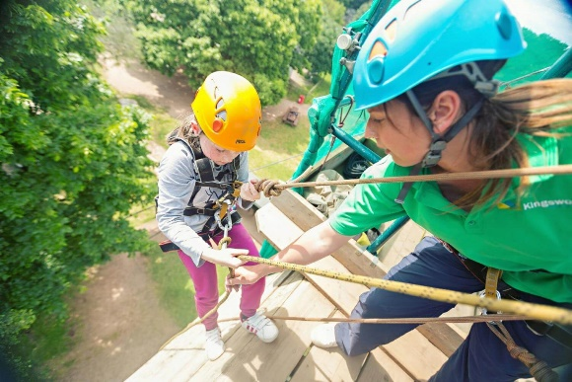
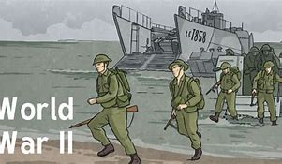

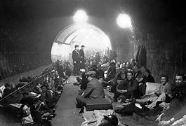
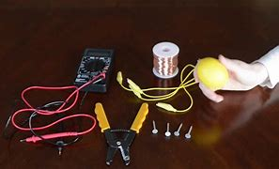
Welcome to Year 4
Spring term: Our History and Geography focus is: WW2
In Science we will be focusing on: Electricity and Sound
One night residential – Frontier Centre

Slide 12
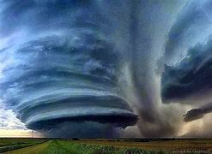
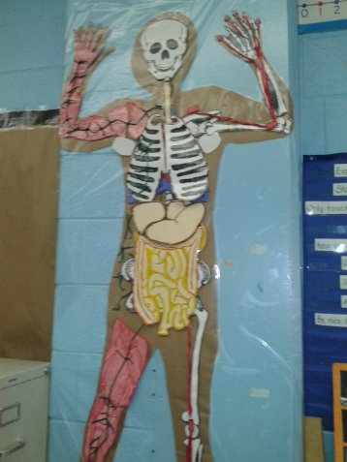
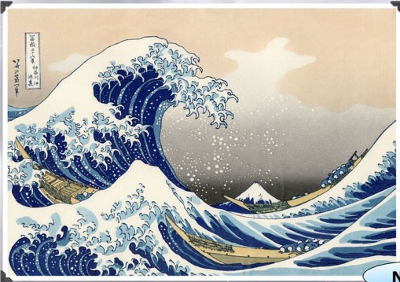
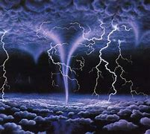
Welcome to Year 4
Summer term: Our History and Geography focus is:
Epic Earth and Inspirational People.
In Science we will be focusing on:
Human digestive system
Visit: Faith Tour in Bedford
Leavers’ Picnic
Leavers’ Assembly

Slide 13

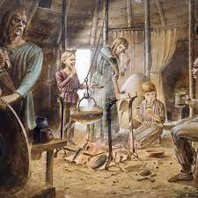

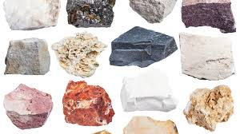
Year 3
Autumn: Our Geography and History focus will be ‘Changes in Britain: Stone Age-Iron Age’
In Science we will be focusing on: Rocks and soils
Celtic Harmony visit

Slide 14
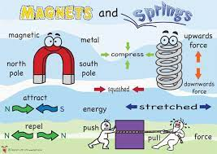
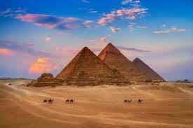
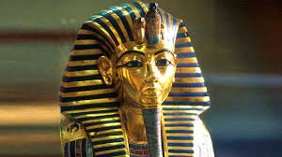

Year 3
Spring: Our History and Geography will focus on ‘Ancient Egypt’
Egyptians.
In Science we will be focusing on: ‘Forces & Magnets/ Light’
Swimming lessons

Slide 15



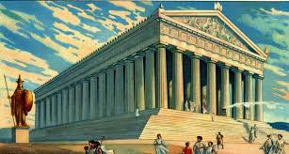
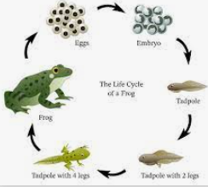
Year 3
Summer: Our History and Geography will focus on
‘Ancient Greece’
In Science we will be focusing on: ‘Plants and Animals’

Slide 16



https://mathsframe.co.uk/
In KS2 we focus on regular times table practice.
The children will take part in their times table test in the Summer Term of year 4.
During the times table test, children are asked to complete 25 questions at random. These include up to the 12 times tables and are presented in a randomised way. They may be presented as multiplication questions or division questions. The test is timed, where pupils will be given 6 seconds to give an answer before they are moved onto the next question.
The pass mark is 25/25.
We ask that pupils regularly practice their times table tests at home to support their learning. Your child has a Times Table Rock Stars log-in at the back of their reading records. House points will be given for anyone that completes at home and it is recorded in their Home/school book.

Slide 17

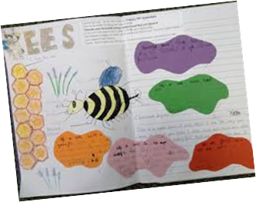
Spellings: Spellings will be given weekly. Spelling activity sheets should be taken home every Friday and returned following Friday. Pupils weekly spellings will be in their Home Learning books. Common exception words are regularly tested (half termly) and we ask that you practice reading and writing these with your children on a regular basis
Learning Logs: . Children will receive a table of activities in their Learning Log and will be able to choose different activities to carry out for their Learning Log task. They have the whole half term to complete the activities they choose. Please feel free to present homework in different ways e.g. models, art work. Have fun and be Creative!
Times table practice: We expect the children to practice their times tables regularly. Times Tables Rock Stars is a good way to do this and one the pupils will be used to using. House Points will be given for regular use of this resource at home.
Reading: We expect the children to read to an adult at home every night, as part of their weekly homework. Children who read each night will receive a House Point the following day.

Slide 18
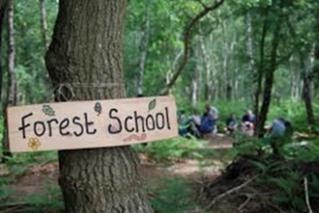
Forest School
Year 3 - Autumn 2 and Summer 1
Cedar – Monday
Elm – Thursday
Hawthorn – Friday
Year 4 - Autumn 1 and Spring 2
Ash – Thursday
Beech – Tuesday
Hazel – Friday
Forest school is led by Mr Tilbury. The children will spend time once a week in the school forest area or Chicksands Woods. The children can come to school in their Forest School clothes and bring their uniform with them to change into afterwards. Please make sure that the children wear warm clothes that you don’t mind getting dirty or wet. We will endeavour to go in most weather so please make sure that they have appropriate footwear and clothing. Forest School will only ever be cancelled in extremely high winds or storms.

Slide 19
Trips and Visits
Year 3 | Year 4
Celtic Harmony Swimming Lessons | Frontier Centre Residential Faith Tour

Slide 20

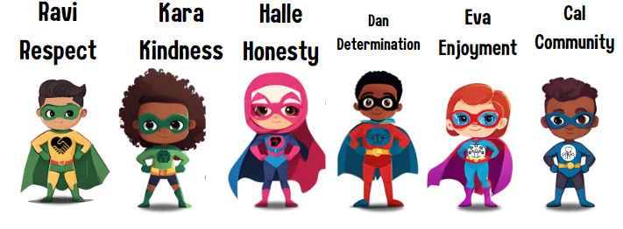

Slide 21
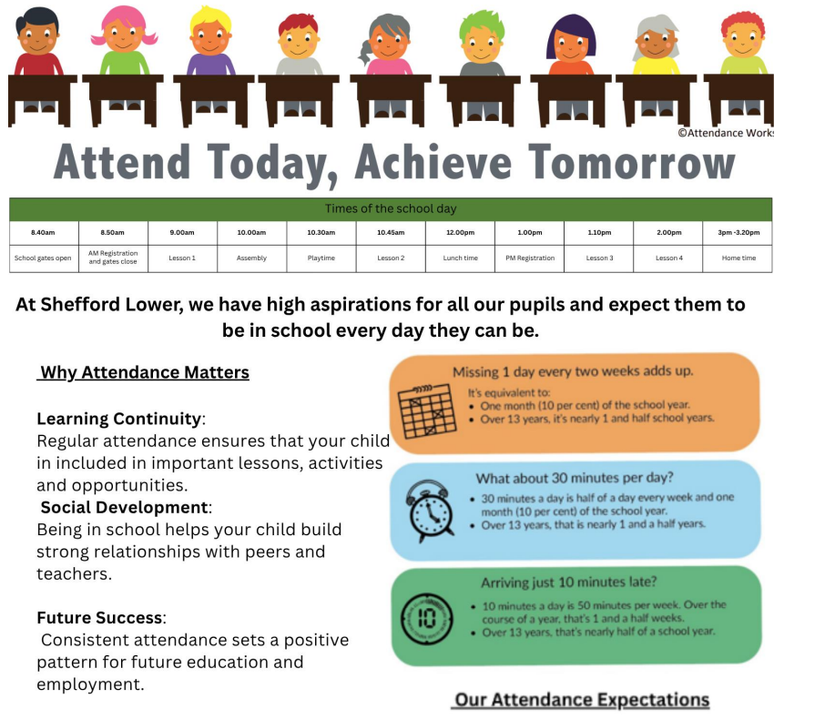
Attendance

Slide 22
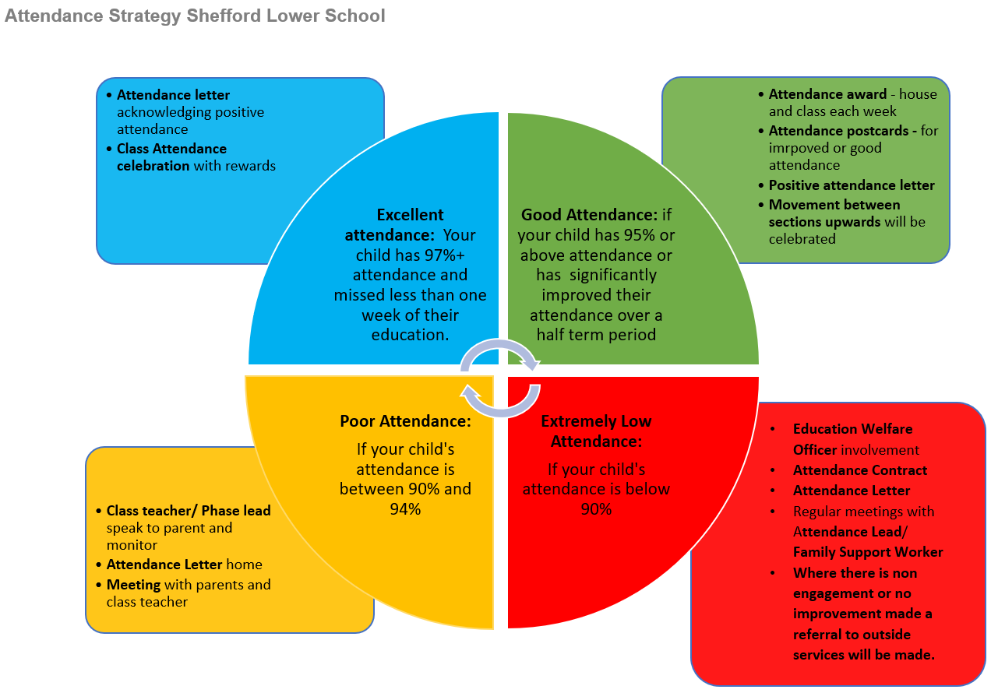

Slide 23

Healthy Eating

Slide 24
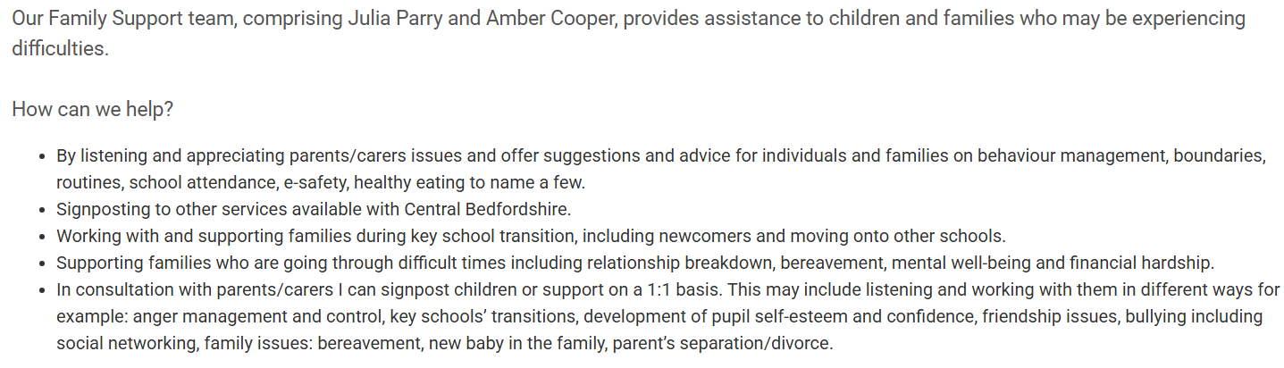

Family Support

Slide 25


Slide 26


Slide 27


